Slide 1

Ending slide
Understanding and Predicting Global Life Expectancy Trends: A Data-Driven Approach
8 out of every 10 predictions were accurate
23rd July 2024
Data Scientist I Kimutai Kevine
Notes:
This slide contains the editable pieces that were used to build infographic sample
Icons – Eye, PC

Slide 2
Dataset source: UN │ World Health Organization
Data Preparation
Data Cleaning
Feature Selection
Data Transformation
Train-Test Split
Timeframe Covered: 2000 to 2015. Data Size: 2,938 records from countries worldwide. Key Variables Used: Life Expectancy, Country Development Status, Health Expenditure, Adult Mortality, Diseases, Resources and Years of Schooling
Key Stakeholders; Health Policy makers, Researchers, NGO’s, Governments and Global Health Organizations.
Global Life Expectancy

Slide 3
METHODOLOGY│
The project followed the CRISP-DM
Business Understanding: To explore what factors influence life expectancy globally.
Data Understanding: Explored data from WHO covering 2000 to 2015.
Data Preparation: Cleaned and transformed 2,938 records across 10 key variables.
Modelling: Used Linear Regression, Logistic Regression to examine relationships between life expectancy and influencing factors.
Evaluation: Assessed model accuracy and insights to support evidence-based decision-making.
Global Life Expectancy
3

Slide 4
Data Cleaning
Data Preparation│
Removed rows with missing values in key variables to ensure model accuracy.
Handled outliers to prevent distortion of results.
Feature Selection
Focused on 10 impactful variables.
Life Expectancy, GDP, Adult Mortality, Diseases, BMI, Schooling, Income.
Data Transformation
Encoded the Status Column into numerical values for analysis.
Normalized numeric values where necessary to improve model performance.
Train-Test Split
Divided data into 80% training and 20% testing sets.
Applied 5-Fold-Cross-Validation to ensure robust and generalizable results.
Global Life Expectancy

Slide 5
Life Expectancy as Influenced by Different Variables
Model Results│
Model Used:
Linear Regression to measure the impact of selected factors on life expectancy.
Key Findings (All Countries Combined):
R-Squared Score : 0.81 → Our model explains 81% of the variation in life expectancy using the selected factors.
Mean Squared Error (MSE): 18.98 → Indicates the average prediction error; lower is better.
Top Positive Influencers (Increase Life Expectancy):
Income composition of resources
Schooling
Total expenditure on health
Top Negative Influencers (Reduce Life Expectancy):
HIV/AIDS prevalence
Adult mortality rate
By Development Status:
Separate models for Developed and Developing countries showed similar trends, but effects were stronger in Developing nations.
Global Life Expectancy
5

Slide 6



Regions under study; North & South America Africa Asia Europe
Regional Insights│
6

Slide 7
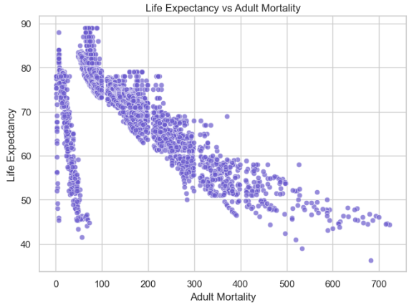
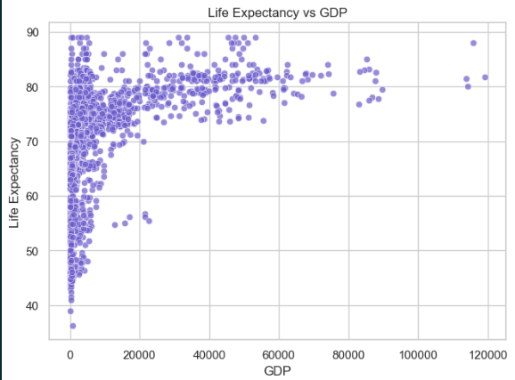
Analysis│
Global Life Expectancy
7

Slide 8
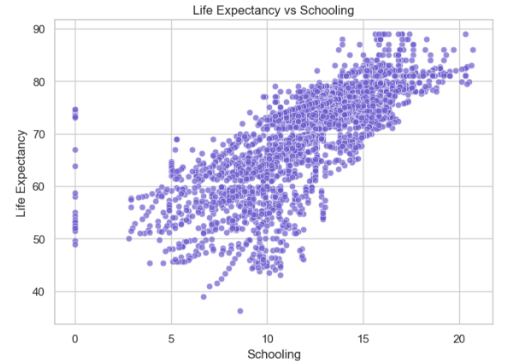
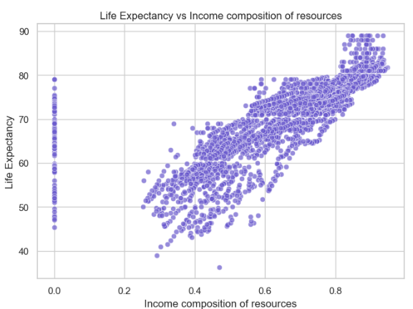
Analysis│
Global Life Expectancy

Slide 9
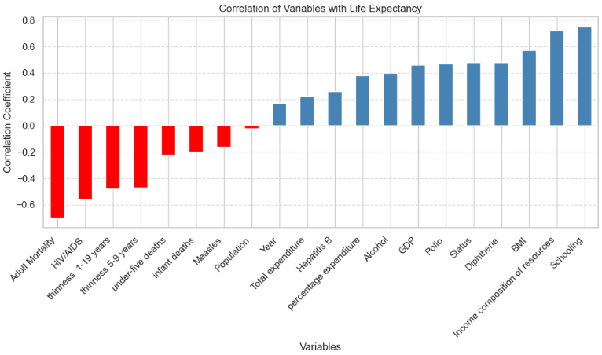
Regression Analysis│
The correlation analysis shows that Life Expectancy is positively influenced by factors such as schooling, income composition of resources, GDP, health expenditure, and immunization rates. These variables are associated with better healthcare access, education, and overall development. On the other hand, negative correlations were observed with adult mortality, HIV/AIDS prevalence, and infant deaths, indicating that higher mortality rates and poor health conditions significantly lower life expectancy. This highlights the critical role of both socioeconomic development and public health interventions in improving global life expectancy.

